Slide 1
Extracting Causal Relations from Electronics & Supply Chain News
Fiona Anting Tan Institute of Data Science National University of Singapore, Singapore tan.f@u.nus.edu
21st Apr 2023
Notes:
To extract the hidden pattern in data to understand the interrelation between factors—in future to establish causality

Slide 2
Temporal Extraction
SUTime (Chang and Manning, 2012 & 2013)
<TYPE> : <VALUE>
CAUSE
EFFECT
Ford India rack ed up more than $ 2 b n in losses over the past decade .
Ford is shutting its car factories in India
DATE: PREV_IMMEDIATE P10Y
The company launched the Sc or pio - N on June 27
and this is expected to help it regain share in the SUV market and capital ise on the demand .
DATE: XXXX-06-27
it showed the nine - dash - line on a map .
Vietnam ordered cinemas to halt screening s of Dream Works Animation ' s " A bo mina ble " last month
DATE: THIS P1M OFFSET P-1M
would cease more than a century of manufacturing in Brazil
and took a $ 4 . 1 billion charge .
DURATION: P100Y
https://nlp.stanford.edu/software/sutime.shtml

Slide 3
Temporal Extraction
SUTime (Chang and Manning, 2012 & 2013)
~15% Cause-Effect examples contain time information (Initial n=100)
How do you want the information to be presented?
CAUSE
EFFECT
Ford India rack ed up more than $ 2 b n in losses over the past decade .
Ford is shutting its car factories in India
DATE: PREV_IMMEDIATE P10Y
https://nlp.stanford.edu/software/sutime.shtml

Slide 4
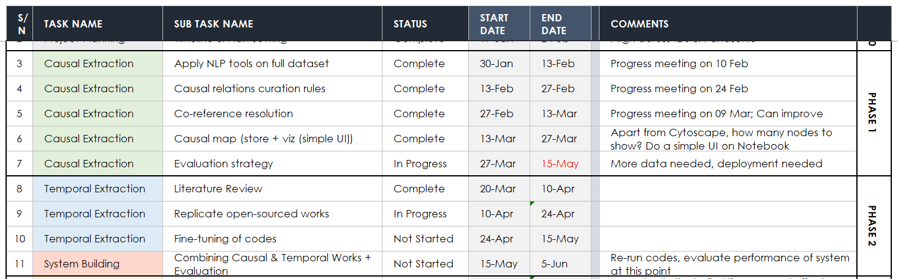
Timeline
Notes:
"D:\66 CausalMap\Panasonic_Electronic_KG\Panasonic_Timeline.xlsx"

Slide 5
Processed Files
I can send over the final graph (used in our Paper), for your team to study/ demo with the users to get feedback:
graph.csv (With original spans)
graph_clustered.csv (After spans are clustered)
graph.gml (Use this with Cytoscape)
Download Cytoscape here

Slide 6
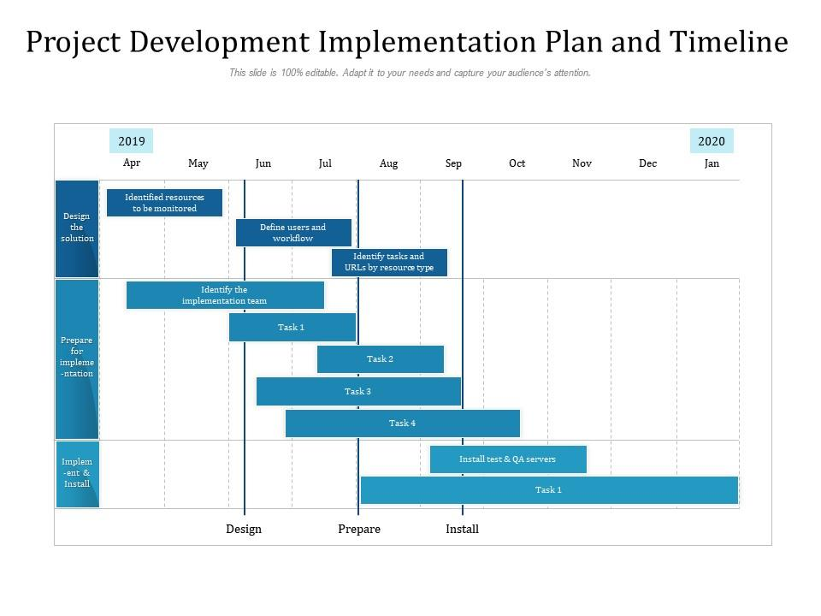


Implementation Plan
Find a template
Plan short-term and long-term targets
Indicate stakeholders and responsibilities
See: https://www.govtech.com/sponsored/creating-an-ai-implementation-strategy
1. Crawl data daily/weekly/monthly
2. Data storage & management
3. Feed data through Cause-Effect extractors & graphing tool
4. Display graph/ create dashboard
5. User interaction & evaluation
IT Dept.
IT Dept.
IT Dept.
IT Dept.
Sales Division

Slide 7
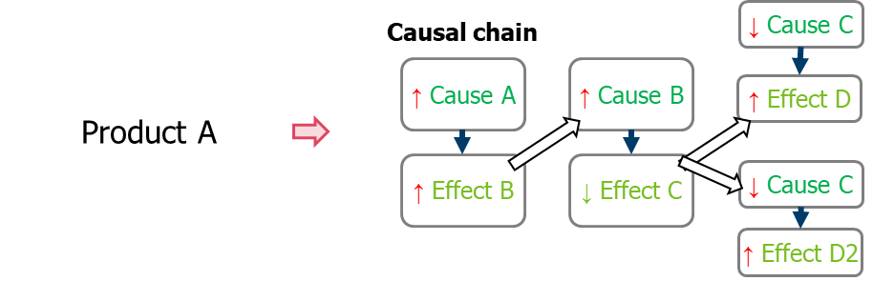
Discussion
Causal relations curation rules: All, add levels to the CE extracted
Prototype data size: Full dataset, or split by quarters
Evaluation strategy: In Progress
Product identification
Temporal & sentiment aspect : In Progress
Importance of other relation types
Cross-sentence relations
Source: Panasonic Industry
Notes:
Review/ Summary Slide

Slide 8
CONCLUSION

